Slide 1
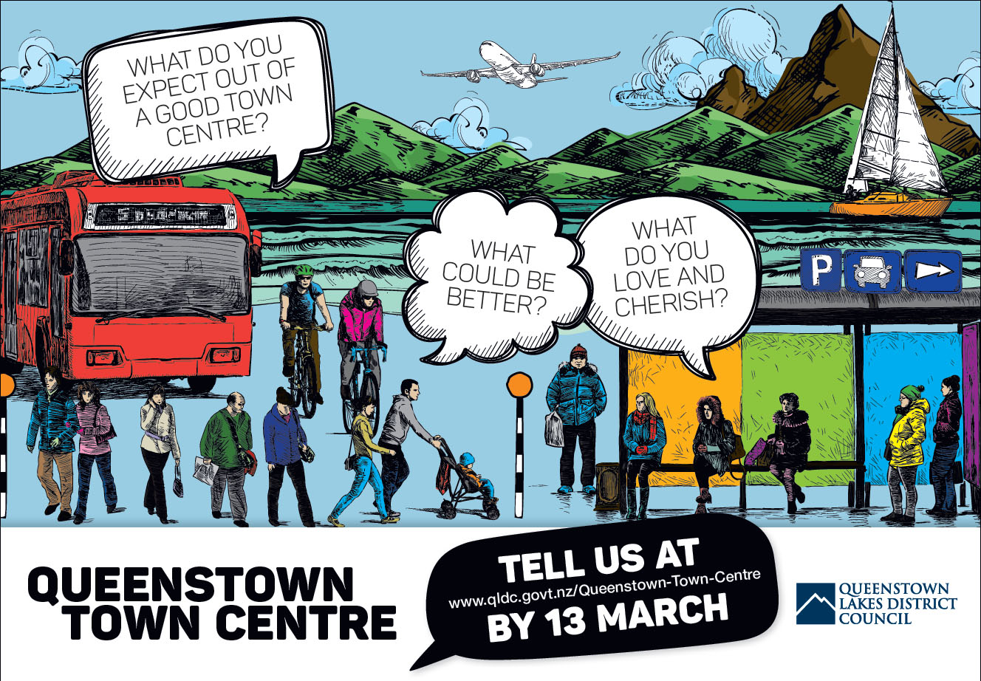

Slide 2
A new approach
Work has started to develop a Masterplan.
Considers all the moving parts of the town centre in an integrated way.
We have a unique opportunity to improve the way our town centre looks, feels and functions.
Continues to be a place that locals love and visitors want to spend their leisure time here.
That is where you come in… your input is important.

Slide 3
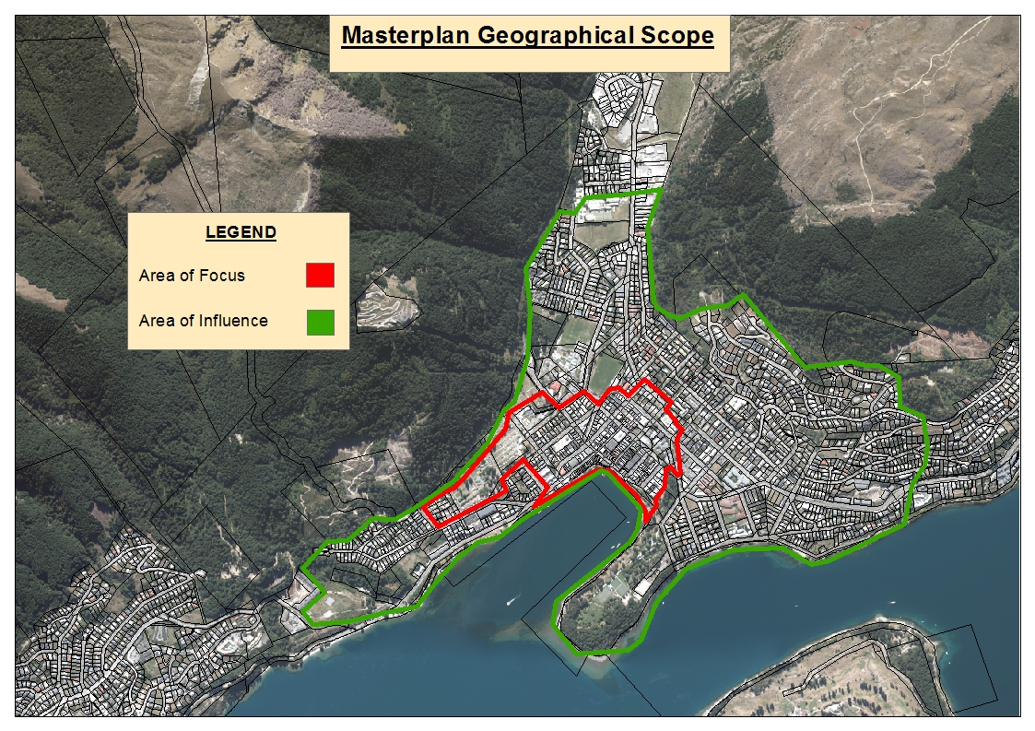
Officially… the town centre is the area in red
Area of Influence = wider project area of influence.
But in reality, the area of influence spans much wider – arguably the whole district.

Slide 4
Yep… we’ve got some challenges
Parking woes
Congestion issues
Public transport is too expensive
Safety concerns for pedestrians and cyclists
Affordable worker housing
What else should we add?
But… challenges are opportunities in disguise

Slide 5
Our goal for the masterplan is to:
Having a clear vision.
Creating efficient public transport hubs.
Getting ahead of the game with managing traffic.
Creating accessible streets that are easier for users.
Enabling a variety of housing that is close to town.

Slide 6
Our goal
Getting smarter about how we manage the demand for parking.
Keeping an eye to the future and innovation in mind.
Making sure we have quality cultural and civic facilities.
Helping our community source Government funding.

Slide 7
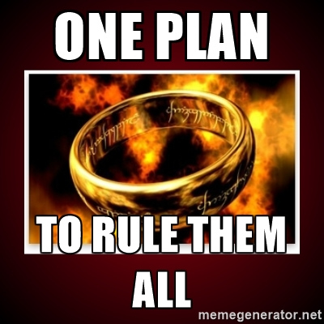

Slide 8
Your input is important
This is just the beginning of our conversations with people from all parts of the community...
Your input today will help us to come up with new vision and give us important insights into how young people perceive their Town Centre.

Slide 9
Group Activity
TBC

